Slide 1

Intro to Machine Learning
Griffin Cosgrove

Slide 2
What is machine learning?
Creating a data set and optimizing a statistical model to ultimately solve a problem
Note: Algorithm(s) performs the optimization for us
Notes:
The algorithm performing the optimization for us is important because it saves time and is usually more accurate.

Slide 3
Why is machine learning becoming more popular?
More efficient and powerful processors (Moore’s law)
More powerful hardware allows machine learning algorithms to learn faster
Abundance of data allows machine learning algorithms to output more accurate results
Notes:
Emergence of GPUs for training deep neural networks, Why?
GPUs can do complex matrix operations more efficiently mostly because of bandwidth and parallelism.
GPUs have more bandwidth, which refers to the amount of memory can be used to execute a task.

Slide 4
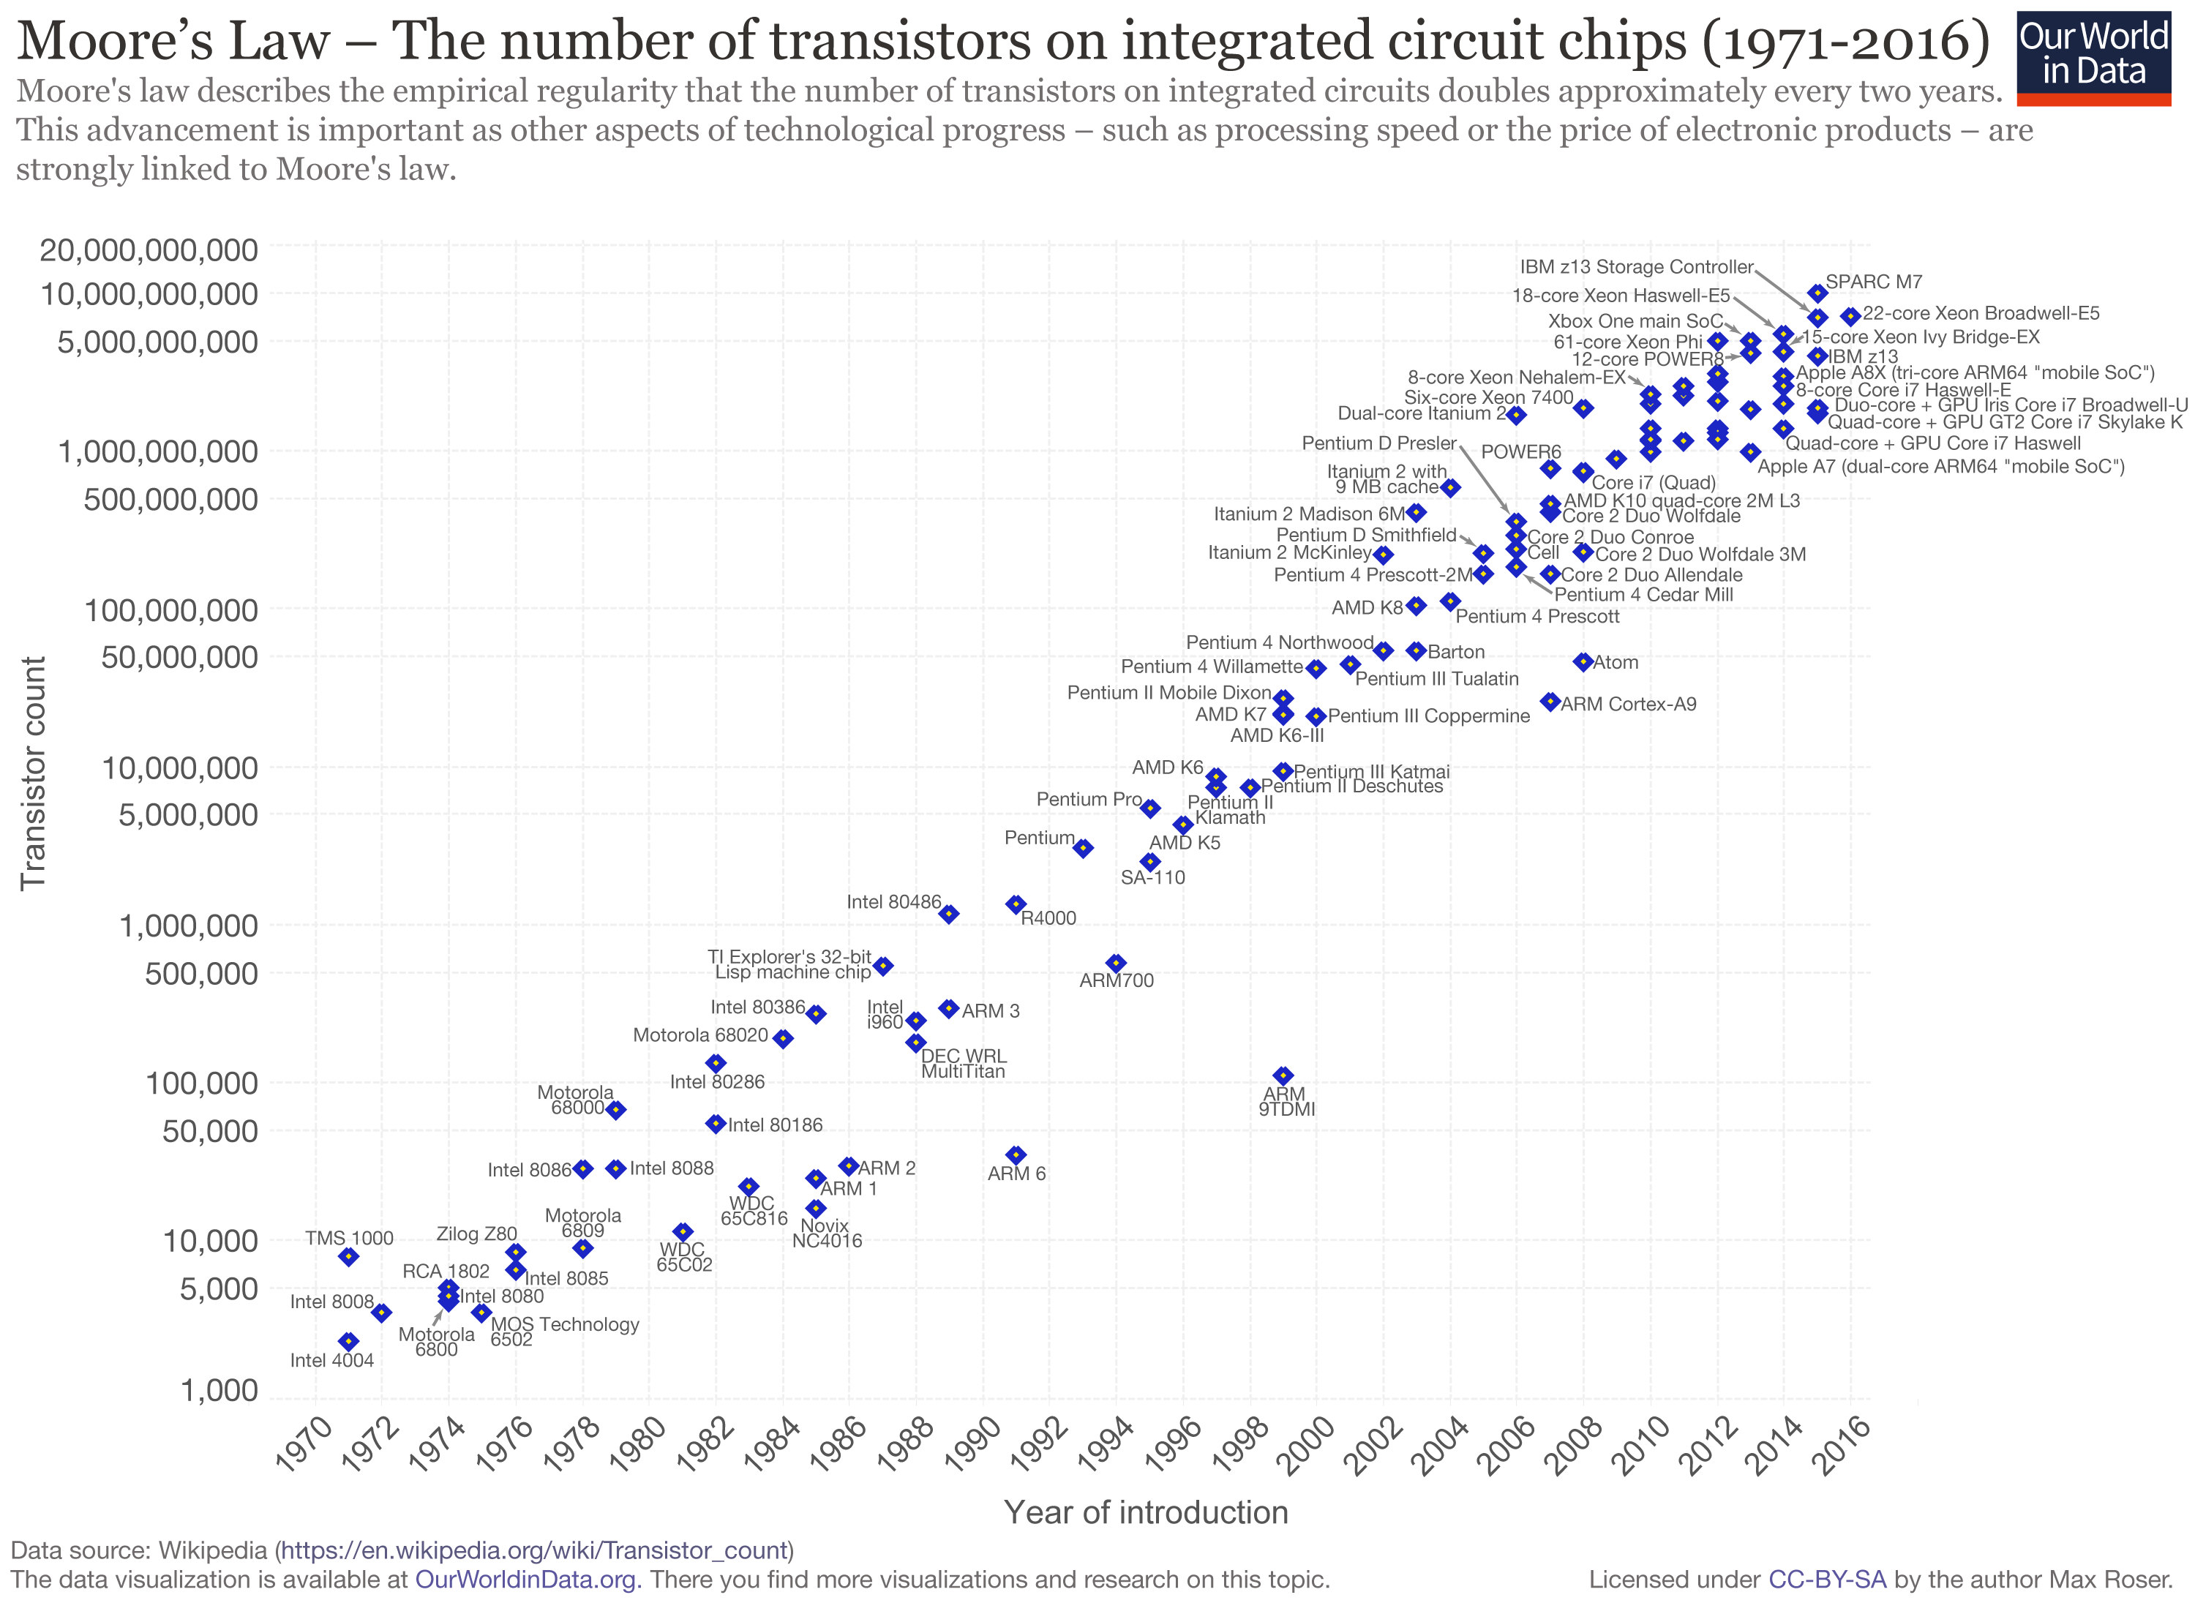
Moore’s Law Visualized
Notes:
https://en.wikipedia.org/wiki/Moore%27s_law
Moore’s law states that about every 2 years the number of transistors on integrated circuits double. This is important because as Moore’s law remains true the speed of computer chips keeps increasing, and the price of increasingly powerful computer chips is decreasing. Ultimately we have access to faster yet cheaper computer chips than ever before.

Slide 5
General Outline of a ML Algorithm
Data Set (Input)
Model
Output
Notes:
Note that the data set is the input for the model and the output is usually a prediction from the model.

Slide 6
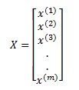
Basic Learning Types
Supervised learning – Key Characteristic: Data set is labeled examples
Example- Classification –> Spam filter
Example – linear regression –> housing market
Unsupervised Learning – Key Characteristic: Data set is unlabeled examples.
Example Clustering, dimensionality reduction
Feature Vector
Notes:
In supervised learning the goal is to create a model that takes in a feature vector x as input and outputs a label of that feature vector.
A feature vector is a matrix with one column and potentially infinite rows.
This image is a concrete example of a feature vector.
Matrix and vector operations are very common in machine learning.
We will discuss feature vectors later, but for now just understand what a vector is.
An example of supervised learning would be creating a spam filter for email. The data set would be emails labeled as not spam which would be 0 in binary or spam which would be 1 in binary.
It is general practice to use 1 to represent a positive observation.
Data set is emails labeled as not spam(0) or spam(1)
In Unsupervised learning the goal is also to create a model that takes in a feature vector X and outputs an altered vector or a number. Note that the output here is NOT a label.
Clustering for example separates examples into groups.

Slide 7
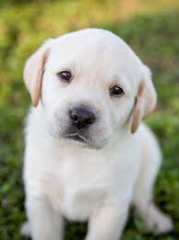





Concrete Clustering Example
Lets Cluster This
Notes:
Note that clustering is UNSUPERVISED so the algorithm would come up with the rules about what makes a picture a cat or dog etc.
This seems obvious to us as humans, because we have been trained to know what a cat, dog, and human face look like.
But the algorithm learns the “rules” of what a dog cat or human face look like and then cluster them based on these rules, so the algorithm.
Notice how the output is not a label of cat or dog, but just clusters.
These human faces were actually generated by a algorithm and those people do not actually exist.

Slide 8
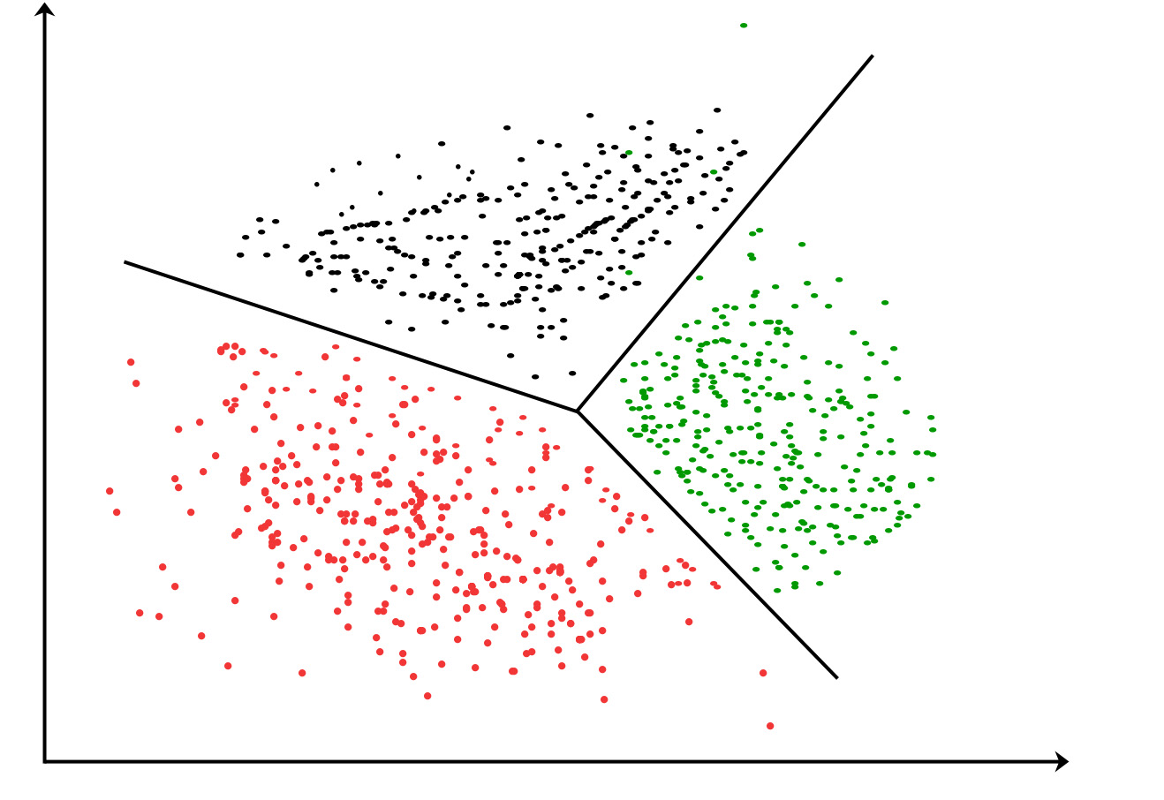
Clustering on a graph
From GeeksforGeeks.com
Notes:
Each dot would represent an instance or observation.

Slide 9


Brief look into GANs
https://thispersondoesnotexist.com/
https://thisresumedoesnotexist.com/
GANs?
Deep Learning
Notes:
GANs stand for general adversarial networks, very exciting new piece.
A GAN is made up of two deep neural networks.
One of these networks, lets call it the generator, is responsible for generating new faces based on a data set of existing faces
The other network, lets call it the discriminator, is responsible for predicting if an image is generated or authentic.
Over time each network gets better over time because they train eachother hence the name adversarial.

Slide 10
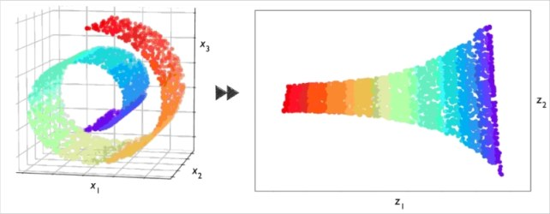
Concrete example of Dimensionality Reduction
3D to 2D Dimensionality Reduction
From www.kdnuggets.com
Notes:
The 3D graph is turned into a 2D graph in this example. This is a concrete example of dimensionality reduction where the input feature vector is transformed to a feature vector with less dimensions.
Another example is dimensionality reduction. Dimensionality reduction takes in a feature vector with many dimensions and transforms the it to a feature vector with less dimensions. One common use of dimensionality reduction is to help humans interpret data because we can only visualize a max of a graph with 3 Dimensions.

Slide 11
And that leads us to foundational knowledge on Data Science and Math ☹
Notes:
To me data science is basically math and statistics applied to technology like python.

Slide 12
Brief word on Data Sets
Training Set – largest
Validation set
Test Set
Old rule of 70%/15%/15% -→ ~90%/5%/5%
Notes:
Import to separate the data set into 3 SEPARATE SUBSETS
Training set is always the largest, and is used to train alglorithm
Validation set is used to choose the specific type of algorithm and configure certain parameters called hyperparameters which we will not be covering today.
The test set is used to test to the algorithm, in which we are testing the accuracy of the model. It is imperative to note that the test set and the validation set CANNOT be in the training set.
If you are wondering why we separate the initial data set into subsets it is because we want to be able to create a model that can PREDICT.
A lot more goes in behind the scenes for picking a data set and normalizing it.
This process cannot be overlooked so I must mention it but know a machine learning engineer will always have to alter the data set in some way,
Weather it be excluding certain features that have poor predicting power or categorical data.
Poor predictors house ex
Catagorical binary.
The old rule used to be around 75% for test and the 15 each for the validation and test set however with the age of big data increasing more machine learning developers are opting for much larger training sets. And this is due to more and more modern data sets with well over 1 million observations/instances.

Slide 13

Features and Feature Vectors
A feature is any characteristic of the example
A feature vector is a 1 by n dimensional matrix comprised of features.
Intuitively
Notes:
Important to note that the vector lets say X would be comprised of observations of the same FEATURE and those individual observations would be referenced in this notation.

Slide 14
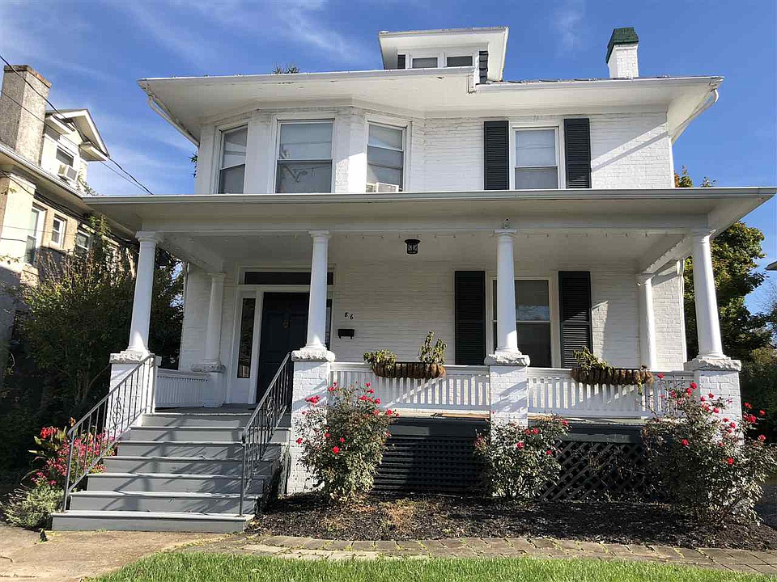

House Feature Vector Example
Concretely say we wanted to make a possible feature vector for a house on the real estate market.
Think of a feature vector as a numerical representation of an attribute for your data set
$$\left[\begin{matrix}2524 \\ \\ \end{matrix}\right]$$
From Zillow.com
2524 square feet
Notes:
A classic application of a linear regression model is predicting housing prices based on features such as bed baths and square footage. A real model would have more features but this is a simplification for clarity.
While this is a simplified note feature vector might not include all things about the instance which has to do with feature selection.
Important to note that the vector lets say X would be comprised of observations of the same FEATURE and those individual observations would be referenced in this notation.

Slide 15
Loss Functions
Generally loss functions are what an algorithm seeks to optimize (minimize)
Think of a loss function as a function that measures error in a model

Slide 16
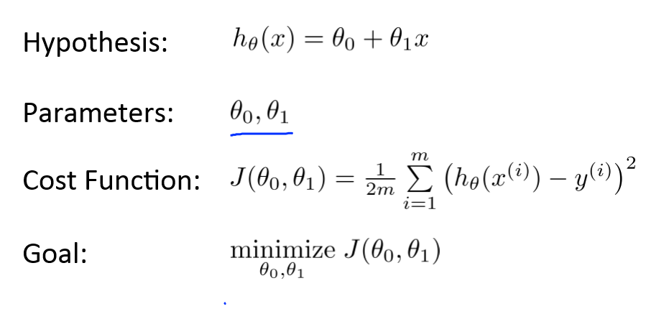
Linear Regression Loss Function (don’t freak out)
From Andrew Ng’s Coursera Course
Notes:
This hypothesis takes the same from as y = mx+b and this makes sense because we are finding the line of best fit.
The parameters theta0 and theta1 are determined by the algorithm.
The cost function looks very daunting however we are going to break this down.
So xi represents an input(feature vector) BUT notice we are taking the function of xi with respect to Htheta so it will be the predicted output
Yi represents the actual output so we are finding the difference between these values
And then we square them and this represents the squared loss.
Then we find the summation of these which represents the rest of the instances AND then then we multiply by one over 2m and m represents the numbers of observations in the data set
AND FINALLY we call this function the mean squared loss function.

Slide 17
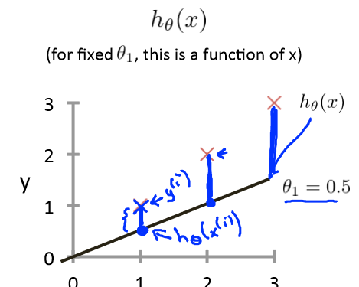
Concrete Loss Function Visualization
For linear regression
Univariate
From Andrew Ng’s Coursera Course
Notes:
Concretely for this example is for linear regression. Each x represents an actual output from the data set. The black line is the predicted line of best fit from the algorithm. So the loss function represents sum the differences or errors. The math behind this is kinda boring and I don’t think I can explain it well enough so conceptually if we understand this we can move forward. To reiterate the goal is to minimize this loss function because that would mean the predictions are very close to the actual data. Important to note this example is specific to linear regression but the objective is usually to minimize the loss function.

Slide 18

We have the basics down now!

Slide 19
Discussion Question #1
Would you purchase and use a self- driving car?
Assuming we could afford it ☺
Notes:
Self-driving cars more safe? Or more potential for security flaws?
Do the good uses of AI outweigh the potential misuse of AI, or future power of AI?
Could we be creating a more powerful species.
There will be a day when there will be more artificial intelligence than human intelligence.

Slide 20
Discussion Question #2
Are there any particular areas where you feel AI should NOT be implemented?
Notes:
Lethal Fully Autonomous Weapons – I have a large problem with this. The lack of regulations in some field could cause serious problems.

Slide 21
Discussion Question #3
Do you think any field (Specifically) will be significantly impacted by AI?
Notes:
Medical fields
Radiology

Slide 22

Additional Resources
One Hundred-Page Machine Learning Book – Andriy Burkov
Andrew Ng’s Machine Learning course on Coursera.com
Fast.ai
Wikipedia – actually helpful for some topics
Army of None – Paul Scharre

